Slide 1
Презентация к уроку английского языка в 3 классе по теме
«ВРЕМЕНА ГОДА»

Slide 2
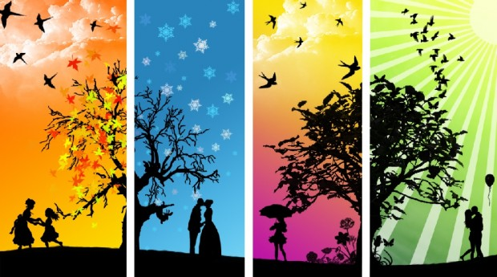
SEASONS

Slide 3
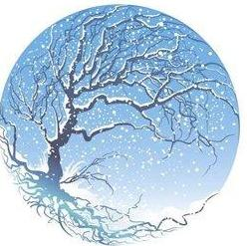
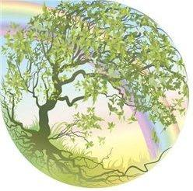
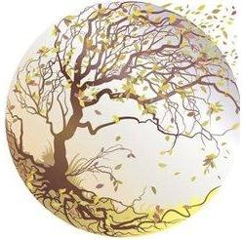
Contents
Winter
Spring
Summer
Autumn

Slide 4
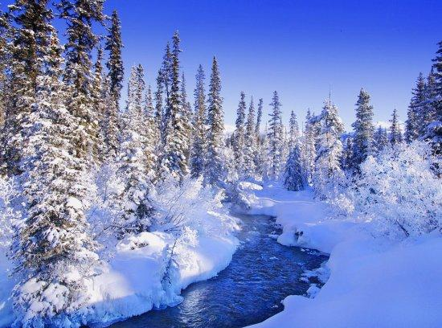
Winter
Winter's cold, the year grows old. Trees are bare, no flowers fair do bloom. The day it's dark and night fires spark. The stream is frozen. Winter's chosen,
cold and bitter.

Slide 5
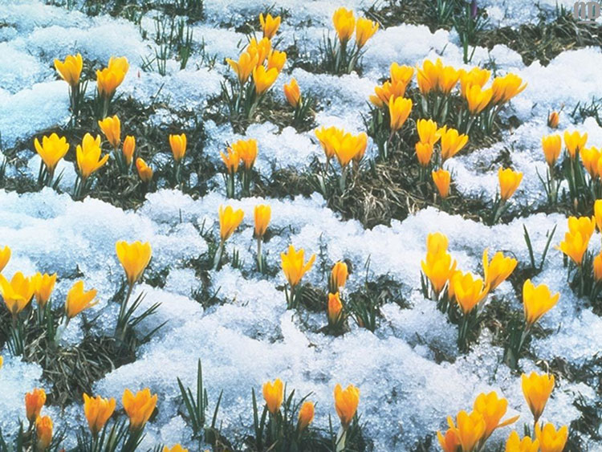
Spring
Green is spring, Bright, fresh, and new. Yellow is the sun, Bright, bold, and true. Blue is the sky, Shimmering and cool.
This is the signal, We've all been waiting for, Spring is here.

Slide 6
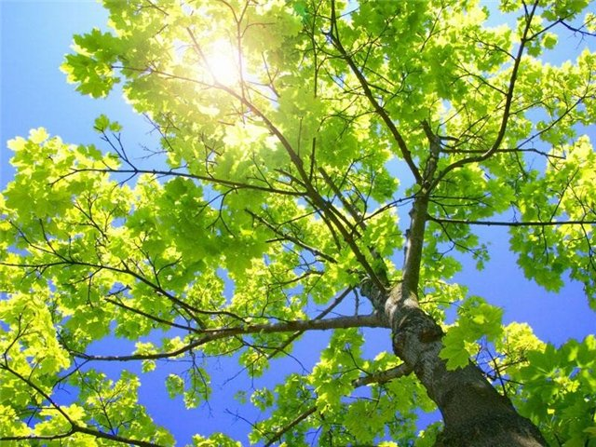
Summer
The sunshine pours in, draw open the curtains. The chirping of the birds, my heart with warmth. Time to get out my bike, get back into shape, become one with nature. To feel the warm grass, dew against my feet. Splash through the cold, water rushing against me.

Slide 7
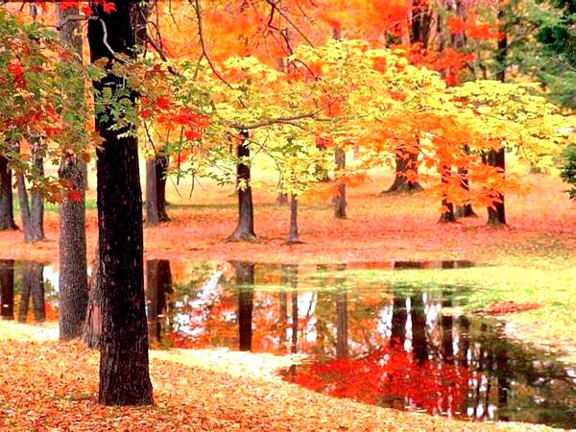
Autumn
Plants are decaying, lifeless and swaying. Shadows are growing, less light is showing. Animals sleeping, no sound or peeping. Golden, orange and yellow leaves glimmer in the setting sun, The whole world knows
that fall has begun.

Slide 8
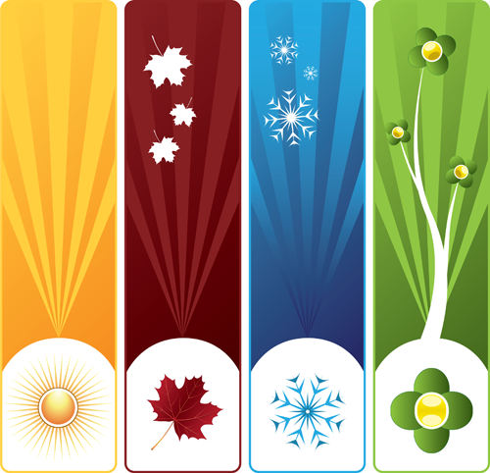
THANK YOU!

