Slide 1
London’s sights

Slide 2
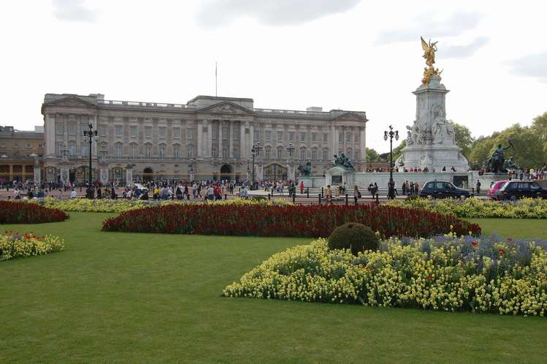
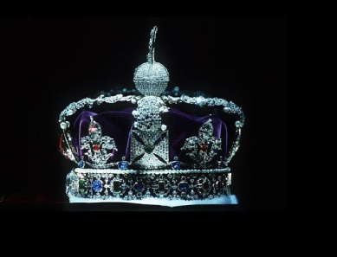
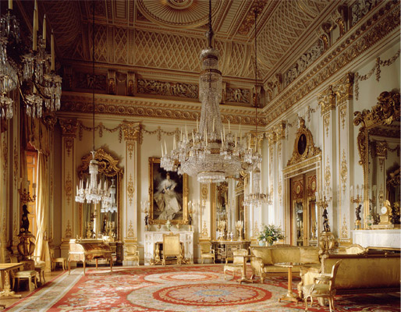
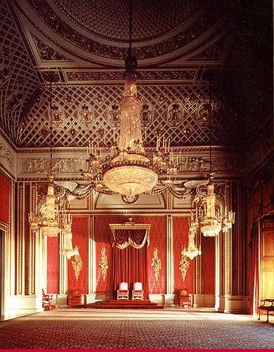
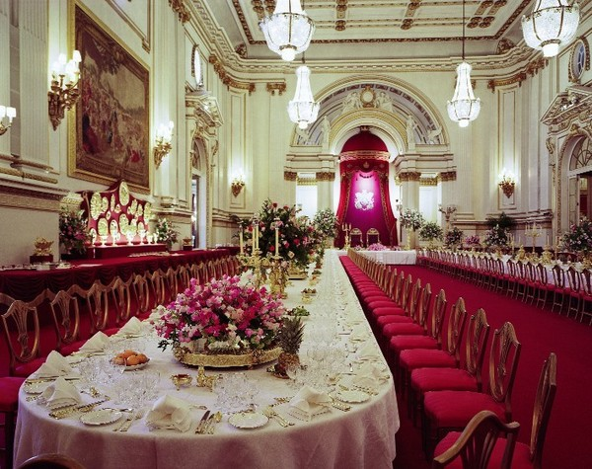
Buckingham Palace
Buckingham Palace
is the most famous place in London. It is the home of the Queen. There are 600 rooms in it. It has an indoor swimming pool and a cinema.

Slide 3
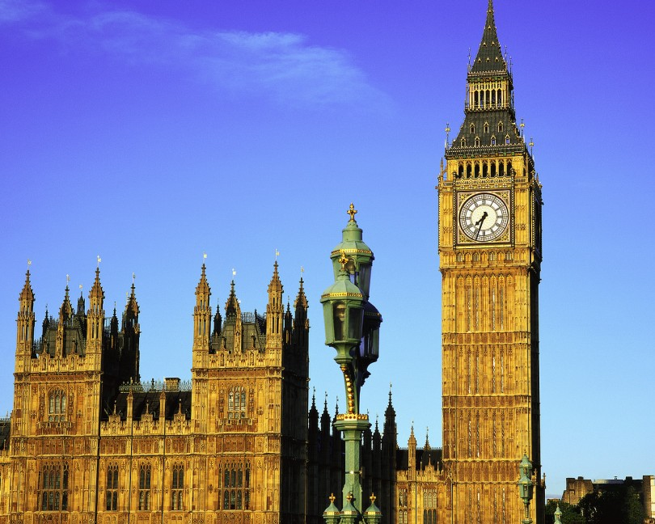
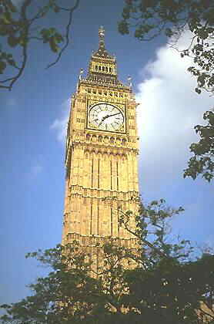
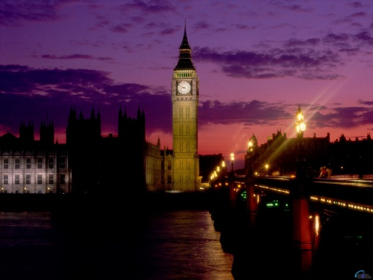
Big Ben
Big Ben is the biggest
Bell in the clock tower in Britain.

Slide 4
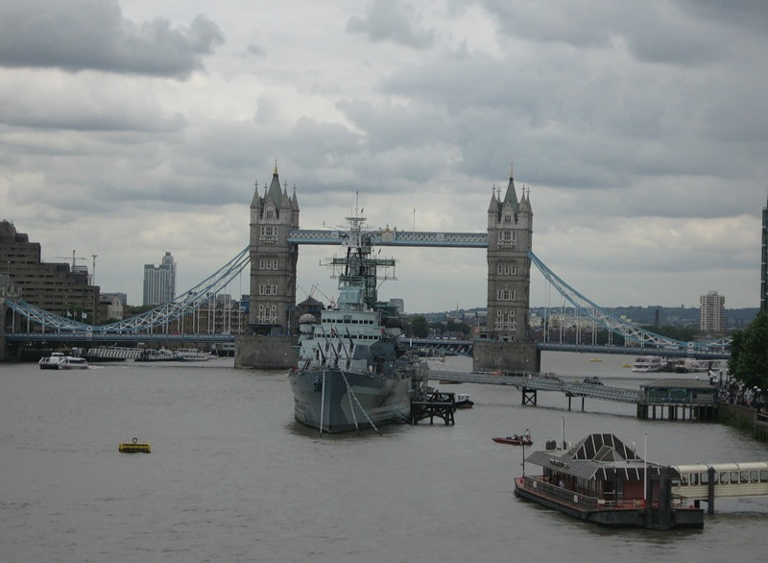
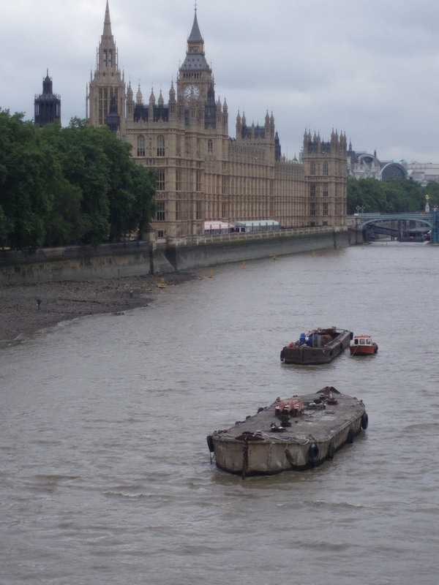
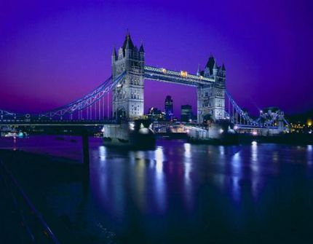
Thames
Here is the river Thames. It runs below the wheel. It is the deepest and most beautiful river in Britain

Slide 5
Hamleys
Hamleys is the biggest toy shop in London. There are six floors with millions of toys.

Slide 6
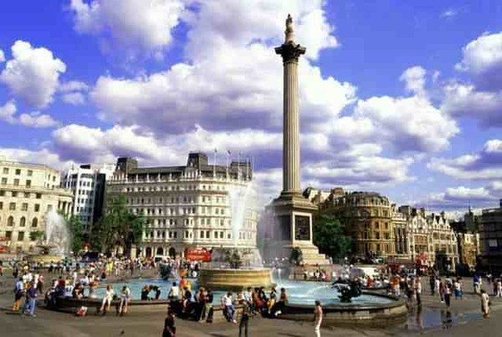
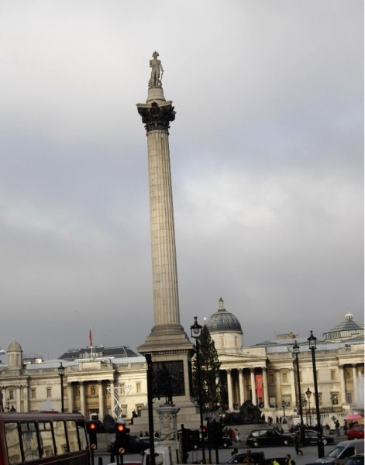
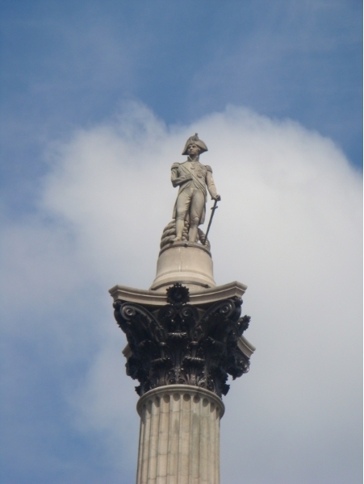
Trafalgar Square
Trafalgar Square is the most popular place for people to meet. In the middle of the square there is Nelson’s Column, which is 51m high.

Slide 7
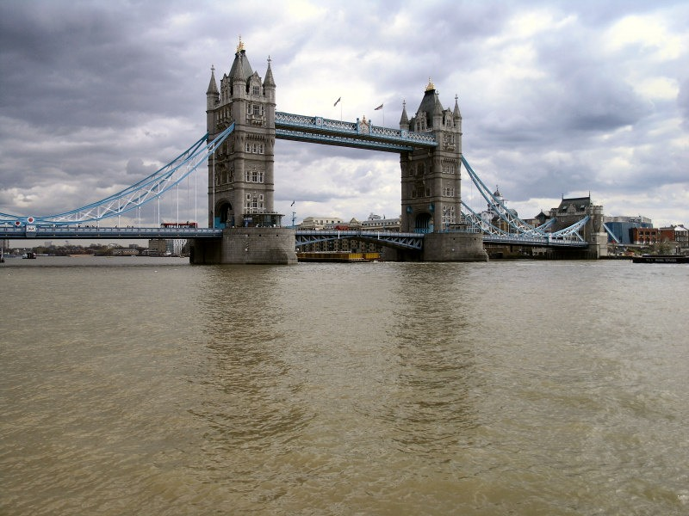
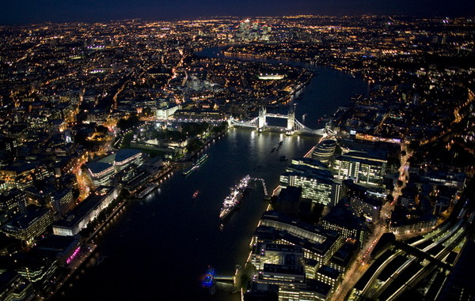
Tower Bridge
Tower Bridge is one of the oldest bridges in London. It is over a 100 years old.

Slide 8
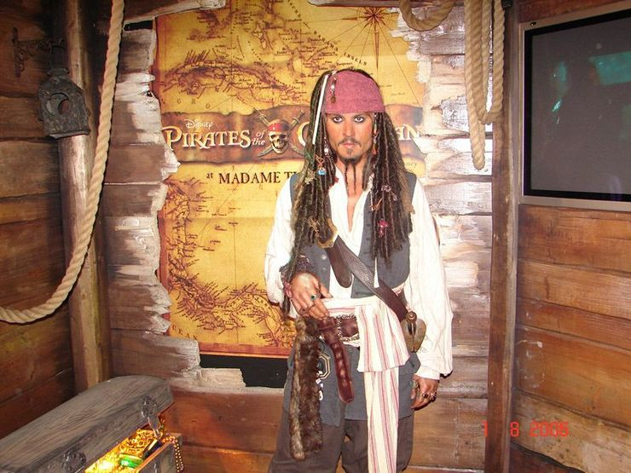
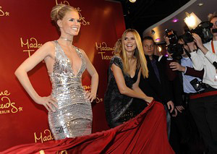
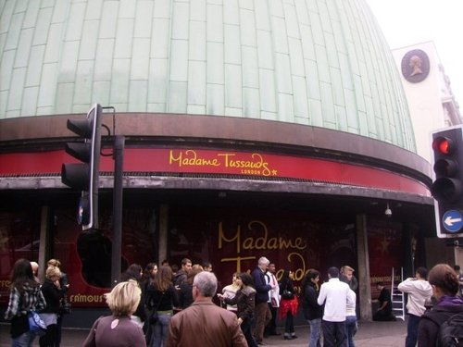
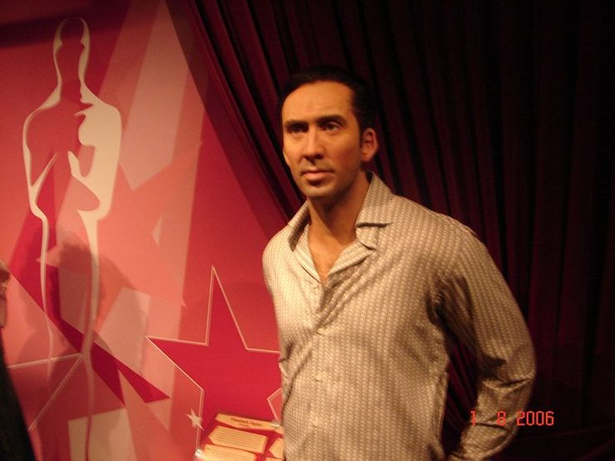
Madame Tussaud’s
Madame Tussaud’s is the world’s most famous waxwork museum. Over two million people go there every year to see wax figures of presidents, film stars
And pop stars.

Slide 9
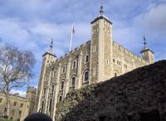
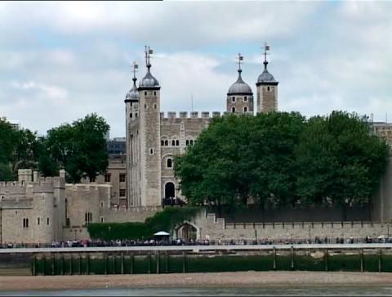
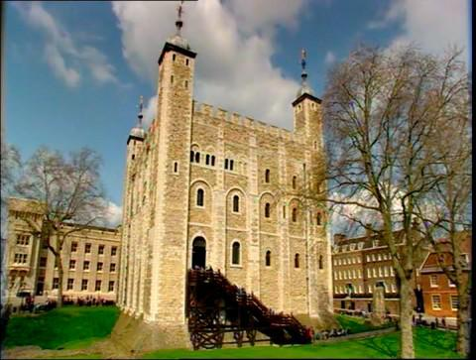
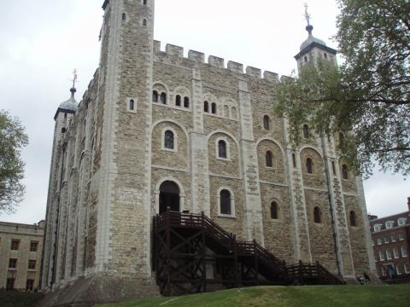
The Tower of London
The Tower of London is a very big castle. It is the oldest place in London. It was a castle, a zoo, a prison and a museum. The most famous things in the Tower of London are the Crown Jewels. They have the biggest diamond in the world – the «Star of Africa».

Slide 10
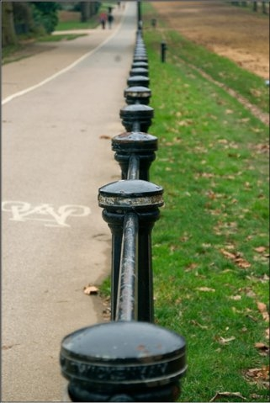
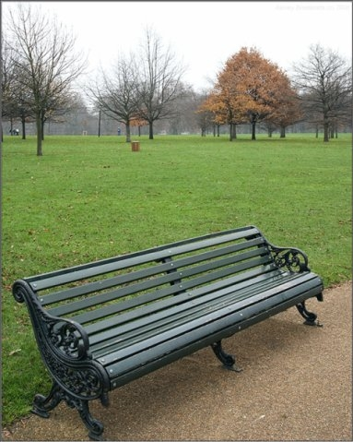
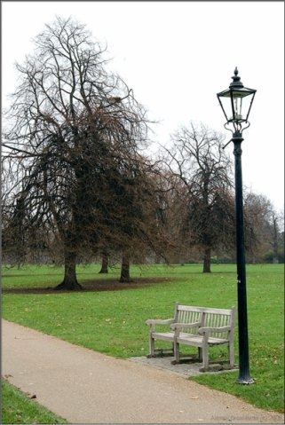
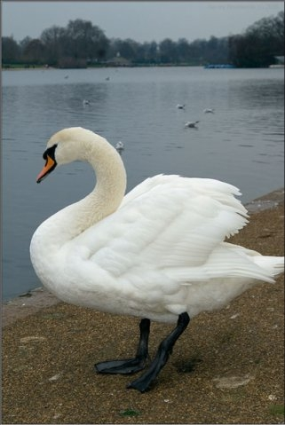
Hyde Park.
Hyde Park is the most famous park in London. It’s a pleasure to watch Londoners walk and jog in the park, eat their sandwiches, talk, sunbathe, read books and enjoy music. There are no signs like” Do not walk on the grass”.

